Slide 1
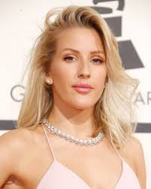
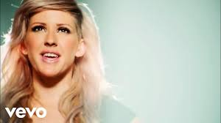
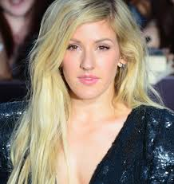
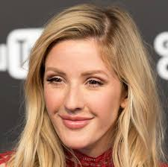
Ellie Goulding

Slide 2
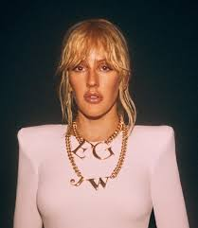
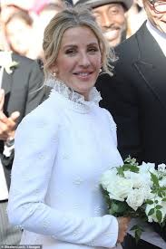
Ellie Goulding
She is very amzing siner.
She was born 30. december 1986 in Hereford
She is 33 years old.
She has 1 brother.
She is married.
She has 14 miloions followers on Instargram .

Slide 3
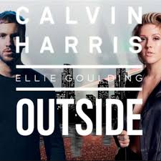
Some somgs that she sang
Love me like you do
Burn
Hate me
Outside
Close to me
Lights
Sixteen

Slide 4
Thanks for paying attention

