Slide 1
PLASTIC BAG
SIMONA GODÁLOVÁ

Slide 2
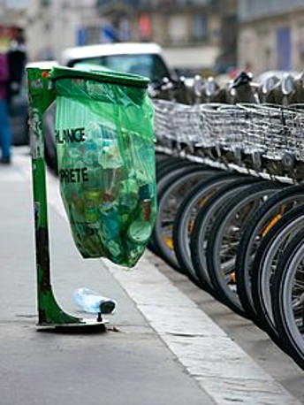
PLASTIC BAG
A plastic bag, poly bag, or pouch is a type of container made of thin, flexible, plastic film, nonwoven farbic, or plastic textile.
Plastic bags are used for containing and transporting goods such as foods, produce, powders, ice, magazines, chemicals, and waste. It is a common form of packaging.

Slide 3
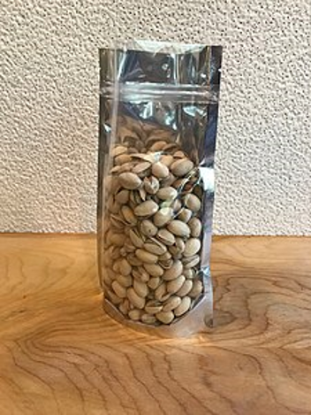
PLASTIC BAG
Plastic bag of water softener salt; handle die-cut through the thick plastic to allow carrying
Stand-up pouch containing nuts

Slide 4
PLASTIC BAG
American and European patent applications relating to the production of plastic shopping bags can be found dating back to the early 1950s, but these refer to composite constructions with handles fixed to the bag in a secondary manufacturing process.
The modern lightweight shopping bag is the invention of Swedish engineer Sten Gustaf Thulin.
In the early 1960s, Thulin developed a method of forming a simple one-piece bag by folding, welding and die-cutting a flat tube of plastic for the packaging company Celloplast of Norrköping, Sweden.
Thulin's design produced a simple, strong bag with a high load-carrying capacity, and was patented worldwide by Celloplast in 1965.

Slide 5
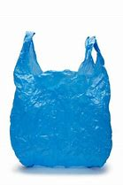
PLASTIC BAG
Plastic shopping bags
Open bags with carrying handles are used in large numbers. Stores often provide them as a convenience to shoppers. Some stores charge a nominal fee for a bag. Heavy-duty reusable shopping bags are often considered environmentally better than single-use paper or plastic shopping bags. Because of environmental and litter problems, some locations are working toward a phase-out of lightweight plastic bags.

Slide 6
PLASTIC BAG

Slide 7
PLASTIC BAG

Slide 8
PLASTIC BAG

Slide 9
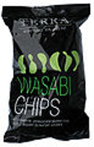
PLASTIC BAG - uses
Snack chips

Slide 10
PLASTIC BAG - uses
Gardening supplies

Slide 11
PLASTIC BAG - uses
Pastry bag with convenience closure

Slide 12
PLASTIC BAG - uses
Intravenous therapy

Slide 13
THANK YOU!

