Slide 1
Robin Hood
Simona Godálová

Slide 2
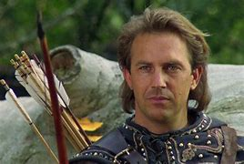
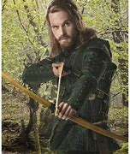
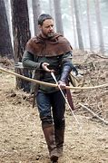
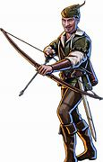
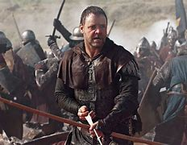
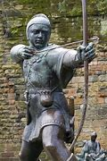
Robin Hood

Slide 3
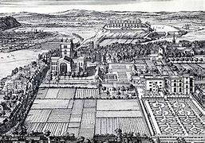
Robin Hood
Robin Hood was an outlaw who, according to legend, lived in Sherwood Forest, near Nottingham.
He regularly fought against his enemy, the Sheriff of Nottingham.

Slide 4
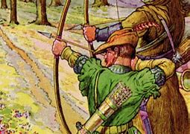
Robin Hood
Robin is known for dressing in green, for being a skillful archer and for robbing the rich to give to the poor.
His band of Merry Men included Friar Tuck, Little John and Will Scarlet.

Slide 5
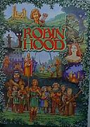
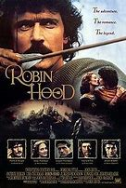
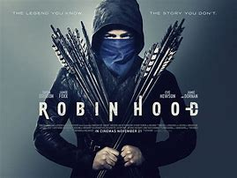
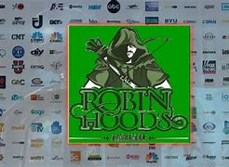
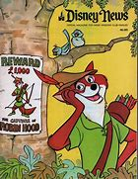
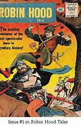
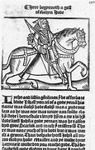
Robin Hood
Robin Hood has been portrayed in over 100 films and many books.
He has been played by Errol Flynn, Kevin Costner and Sean Connery, and portrayed as a fox in the Disney cartoon version.

Slide 6
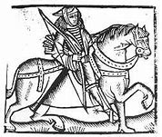
Robin Hood
Robin is usually said to have lived in the 11th or 12th centuries, although the earliest reference to him in a song was during the 14th century.
He is described as a yeoman, or knight.

Slide 7
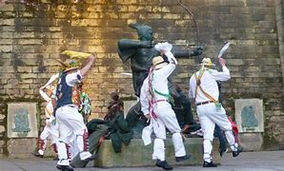
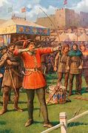
Robin Hood
During the 15th century, Robin Hood became associated with May Day celebrations in England.
He also supposedly met Maid Marian at one of these fairs.

Slide 8
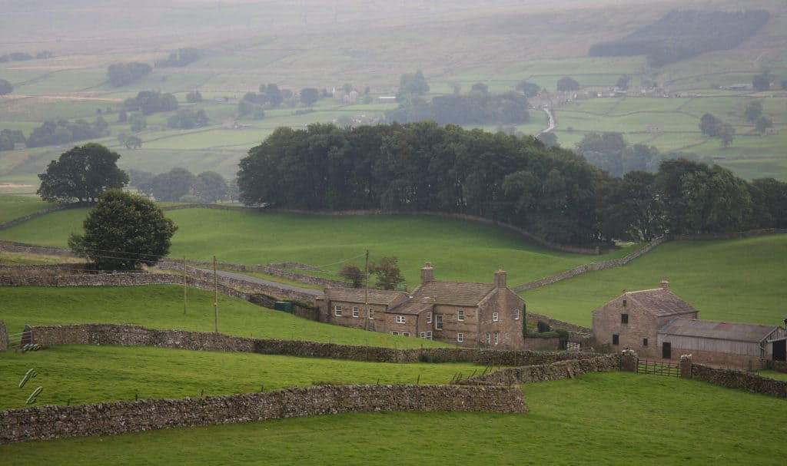
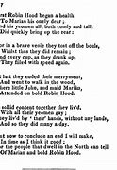
Robin Hood - Interesting facts
The First Robin Hood Stories Are Set in the Twelfth Century
In the Early Stories, He Was Not the People’s Hero
Robin Hood’s Arch-Nemesis Was the Sheriff of Nottingham
Any Historical Robin Hood May Have Been From Yorkshire

Slide 9
Thank you !

