Slide 1
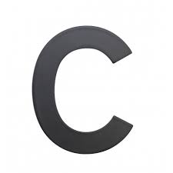
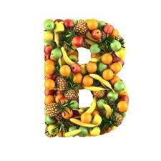
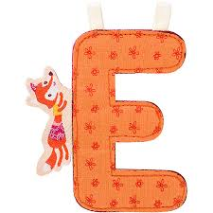
Vitamins

Slide 2
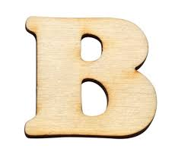
Vitamin b
Vitamin B is a complex of several vitamins.
In the past it was taken as a single vitamin
Several B vitamins: B1,B2,B3,B5,B6,B7,B9,
B12 :B12a,B12b,B12c
Vitamin B is located in: been, nuts,
red meat,pork and spinach

Slide 3
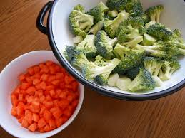
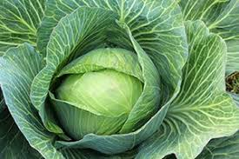
Vitamin a
Vitamin A is in two forms: a1 a a2
Viatmin A is an antioxidant.
Vitamin A is located in: carrot, spinach, green leaves, water melon, cabbage and broccoli

Slide 4
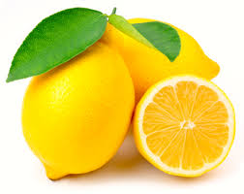
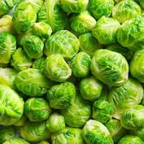
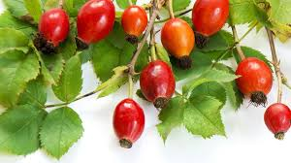
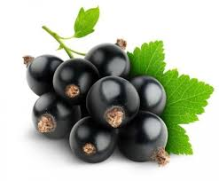
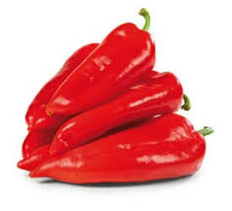
Vitamin c
otherwise ascorbic acid
most of it is in vegetables: brussels sprouts
most of it is in fruit: black ribs
Is located in: lemon, dart, red pepper.

Slide 5
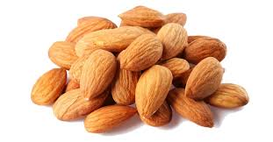
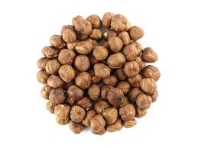
Vitamin e
It is considered an effective antioxidant.
Affects the production of red blood cells.
It slows down the aging process of cells and tissues, so it is added to cosmetics.
Is located in: fish, eggs, milk, peanuts, almonds ...

Slide 6
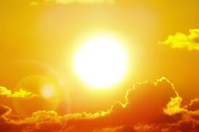
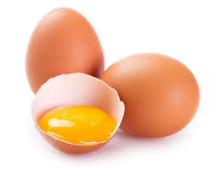
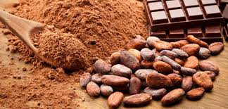
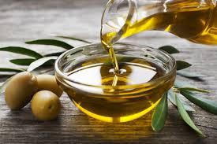
Vitamin d
Vitamin B is the name of a group of vitamins that dissolve in fat.
Several D vitamins: D1,D2,D3,D4,D5
Is located in: sun, kakao, vegetable fats
and egg yolks

Slide 7
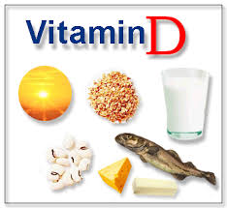
Thanks for your attention

